Slide 1
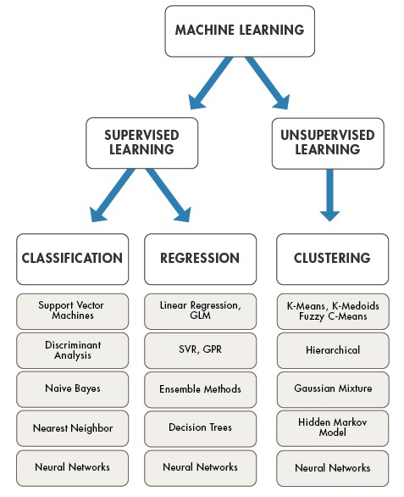
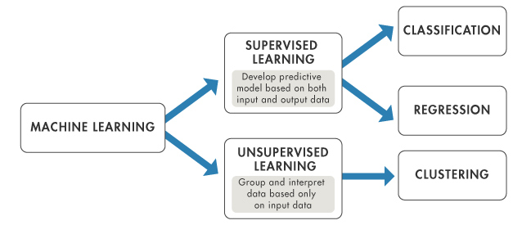
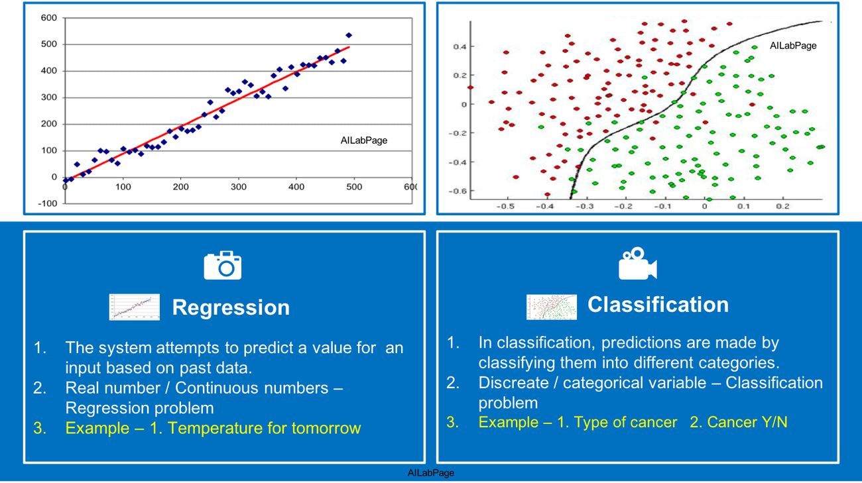
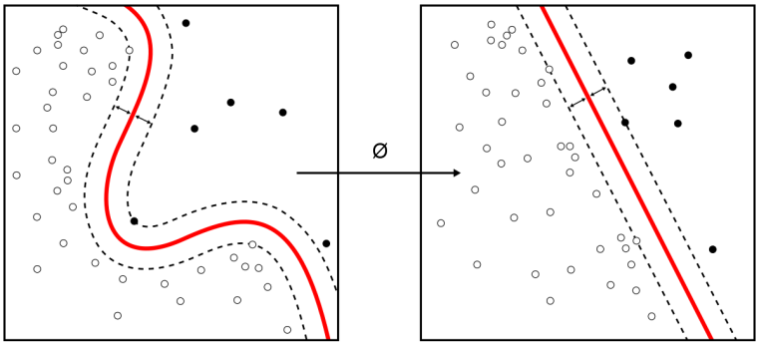
Machine Learning

Slide 2
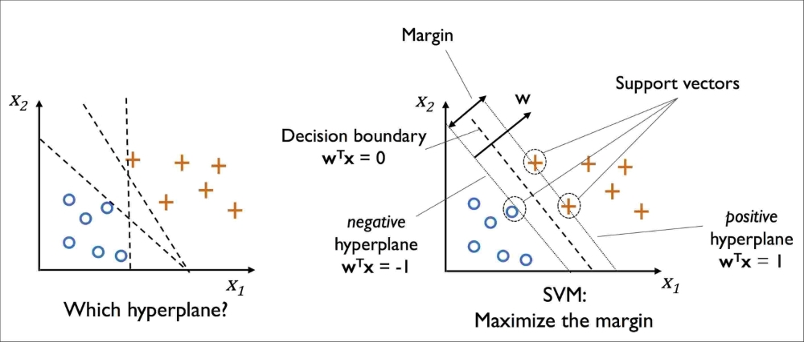
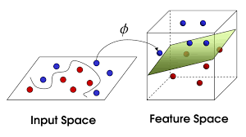
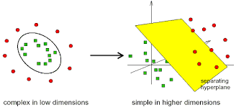
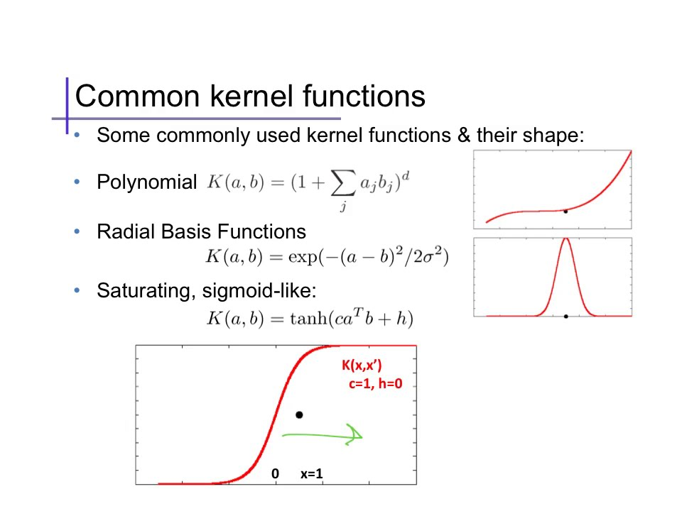
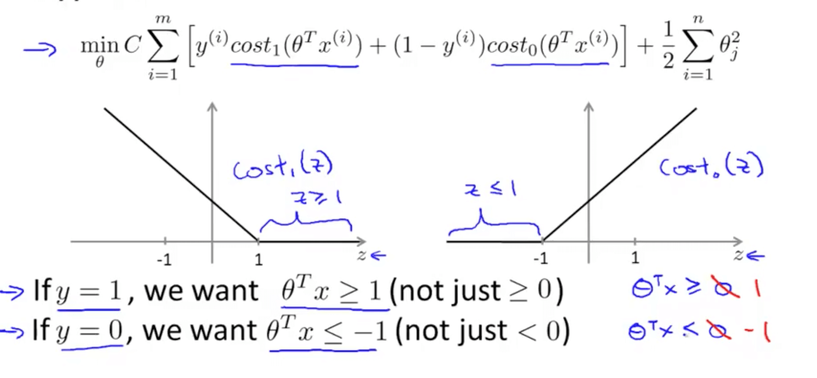
SVM

Slide 3
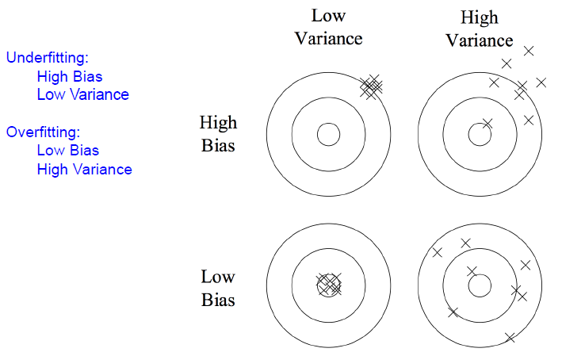
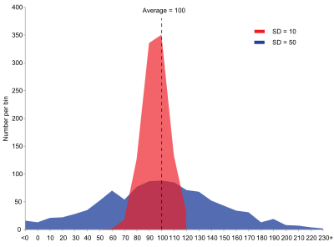
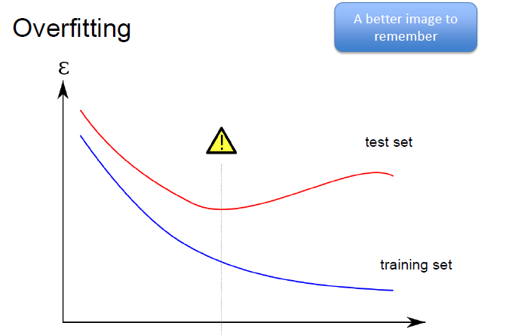

Bias: difference between this estimator's expected value and the true value of the parameter being estimated

Slide 4
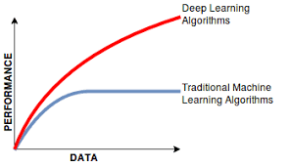
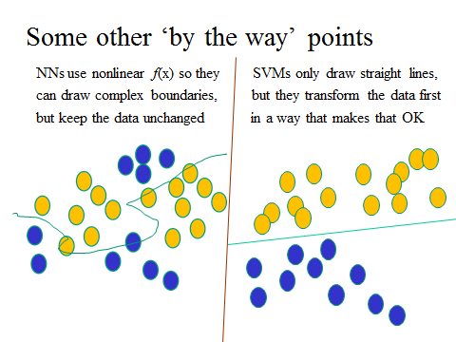
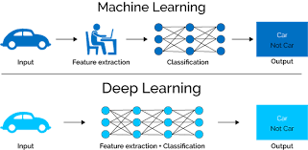
ML-DL

Slide 5
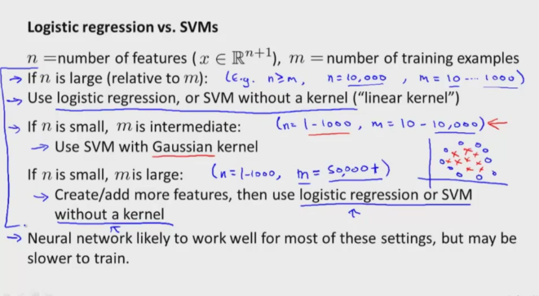
A reasonable amount of data?
Perfect for all the clever classifiers
SVM
Regularized Logistic Regression
You can even use user-interpretable decision trees
Users like to hack
Management likes quick fixes

Slide 6
A huge amount of data?
Sec. 15.3.1
Can achieve high accuracy!
At a cost:
SVMs (train time) or kNN (test time) can be too slow
Regularized logistic regression can be somewhat better
So Naïve Bayes can come back into its own again!

Slide 7
Accuracy as a function of data size
With enough data
Classifier may not matter

Slide 8
Real-world systems generally combine:
Automatic classification
Manual review of uncertain/difficult/"new” cases

Slide 9
Precision and recall
Precision: % of selected items that are correct Recall: % of correct items that are selected
 | correct | not correct
selected | tp | fp
not selected | fn | tn
Notes:
Precision P = tp/(tp + fp)
Recall R = tp/(tp + fn)
Mention precision recall tradeoff.
precision, recall, f-measure [many have seen before]
there are two sets: CORRECT entities and SELECTED entities
2x2 contingency table, four possible outcomes
for precision & recall, you're ignoring bottom corner (where you get O right)
precision: what proportion of your guesses are correct?
note that correctness means (a) correct boundaries, and (b) correct label
recall: what proportion of true entities did you get right?
ASK STUDENTS HERE ABOUT WHY NOT TO USE ACCURACY
[note that there is typically a trade-off between precision and recall!]
[to get high precision, be very reluctant to make guesses – but then you may have poor recall]
[to get high recall, be very promiscuous in making guesses – but then you may have poor precision]

Slide 10
A combined measure: F
A combined measure that assesses the P/R tradeoff is F measure (weighted harmonic mean):
The harmonic mean is a very conservative average;
People usually use balanced F1 measure
i.e., with β = 1 (that is, α = ½):
F = 2PR/(P+R)
Notes:
a combined measure: F-measure: weighted harmonic mean between precision and recall
[why weighted? in some applications you may care more about P or R]
[why harmonic? it's conservative -- lower than arith or geo mean]
[if P and R are far apart, F tends to be near lower value]
[in order to do well on F1, need to do well on BOTH P and R]
[this way, can't beat the system by being either too reluctant or too promiscuous]
Comment: when ppl say f-measure w/o specifying beta, they mean balanced, and this is by far the most common way of doing it

Slide 11
Confusion matrix ‘c’
For each pair of classes <c₁,c₂> how many documents from c₁ were incorrectly assigned to c₂?
c_{3,2}: 90 wheat documents incorrectly assigned to poultry
Docs in test set | Assigned UK | Assigned poultry | Assigned wheat | Assigned coffee | Assigned interest | Assigned trade
True UK | 95 | 1 | 13 | 0 | 1 | 0
True poultry | 0 | 1 | 0 | 0 | 0 | 0
True wheat | 10 | 90 | 0 | 1 | 0 | 0
True coffee | 0 | 0 | 0 | 34 | 3 | 7
True interest | - | 1 | 2 | 13 | 26 | 5
True trade | 0 | 0 | 2 | 14 | 5 | 10

Slide 12
Development Test Sets and Cross-validation
Training set
Development Test Set
Test Set
Metric: P/R/F1 or Accuracy
Unseen test set
avoid overfitting (‘tuning to the test set’)
more conservative estimate of performance
Cross-validation over multiple splits
Handle sampling errors from different datasets
Pool results over each split
Compute pooled dev set performance
Training Set
Dev Test
Training Set
Dev Test
Training Set
Dev Test
Test Set

Slide 13
Cross-Validation
Break up data into 10 folds
(Equal positive and negative inside each fold?)
For each fold
Choose the fold as a temporary test set
Train on 9 folds, compute performance on the test fold
Report average performance of the 10 runs

